Slide 1

Shallow-Water Equations in 1D: Applications of the de St. Venant Equations
Marcus N. Gomes Jr.¹, Marcio H. Giacomoni²
^{1,2}The University of Arizona
Department of Hydrology and Atmospheric Sciences
²The University of Texas at San Antonio
College of Engineering and Integrated Design
Presented by:
Marcus Nóbrega Gomes Júnior , Ph.D.

Slide 2


HydroHP-1D
Bibliography
Gomes Jr, M.N., Rápalo, L.M., Oliveira, P.T., Giacomoni, M.H., do Lago, C.A. and Mendiondo, E.M., 2023. Modeling unsteady and steady 1D hydrodynamics under different hydraulic conceptualizations: Model/Software development and case studies. Environmental Modelling & Software, 167, p.105733.
https://doi.org/10.1016/j.envsoft.2023.105733
Notes:
Photo by Mediamodifier on Unsplash: https://unsplash.com/photos/kML003ksO_0

Slide 3
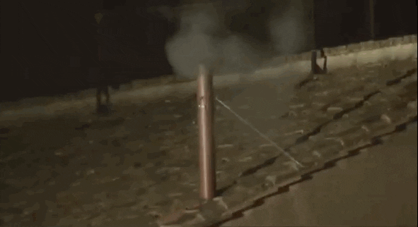
Background and Motivation
Flow is a fundamentally 3D problem
The question is when we can simplify the problem to 2D or 1D …

Slide 4
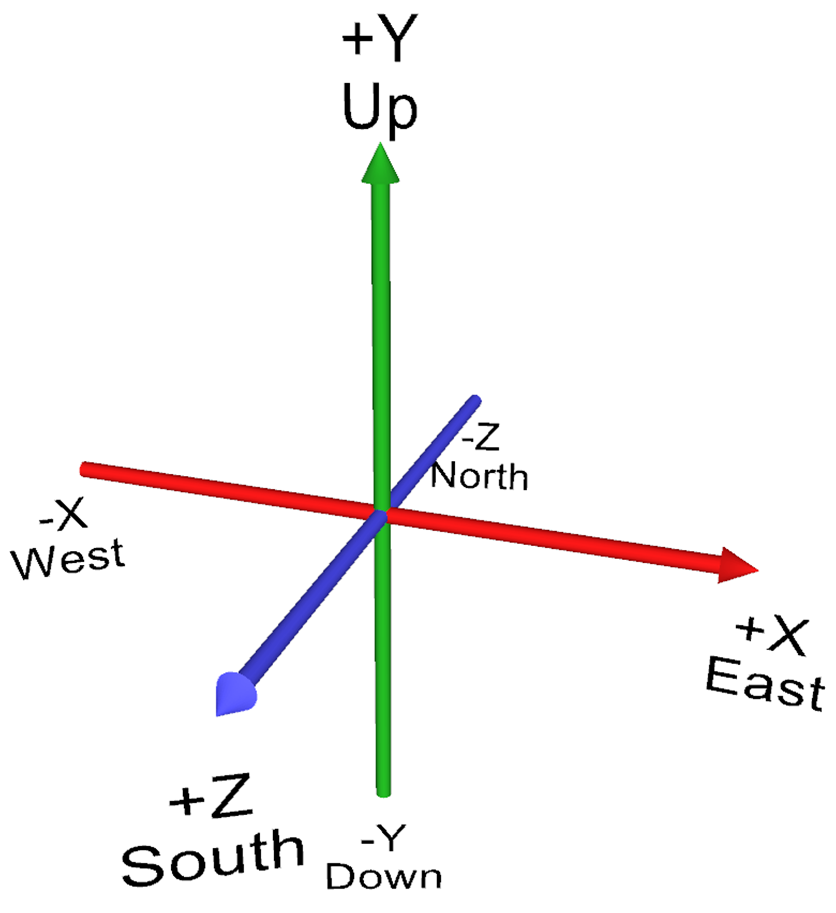
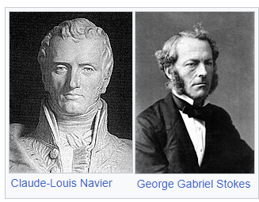
Background and Motivation
Accelerations, velocities, friction, all theoretically occurs varying in x, y, and z
Navier and Stokes developed their most famous equations in 1822, describing how flow propagates

Slide 5
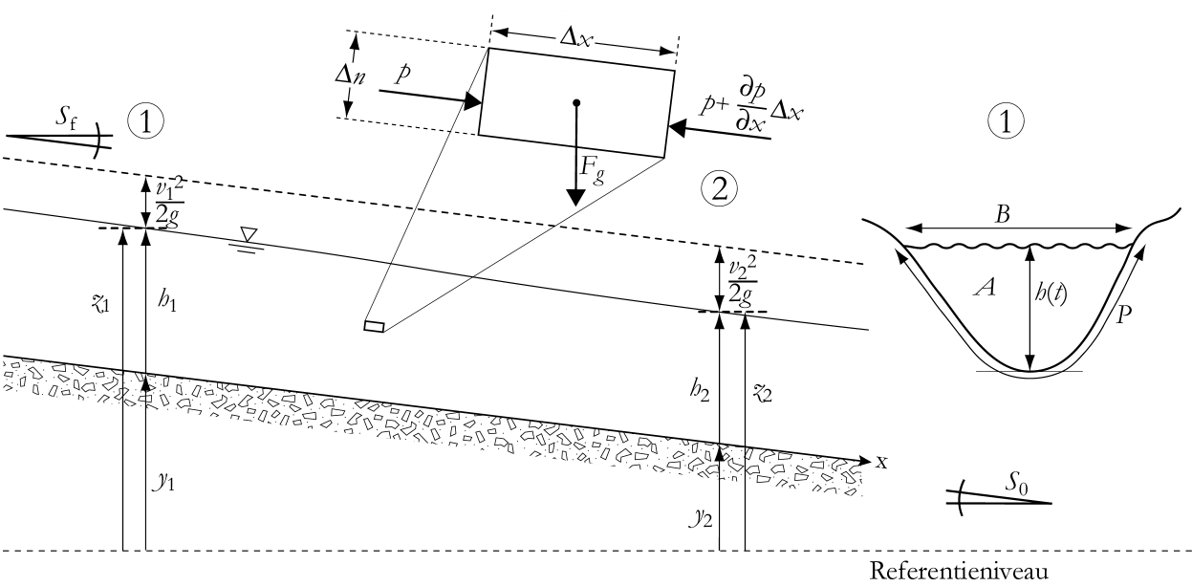
1D Flow Case
Vertical acceleration is neglected

Slide 6
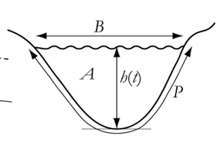


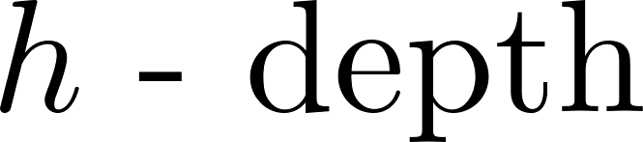

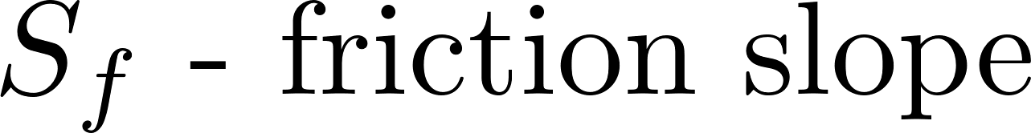
1D Flow Case
Using Newton’s 2nd law, one can derive the 1D momentum equation, which can also be derived from the Navier-Stokes and is summarized by:
Local acceleration term
Convective acceleration term
Pressure force term
Gravity force term
Friction force term
Kinematic wave
Neglect pressure and inertial forces
Effects of inertial forces
Diffusion wave
Neglect inertial forces
Dynamic wave

Slide 7
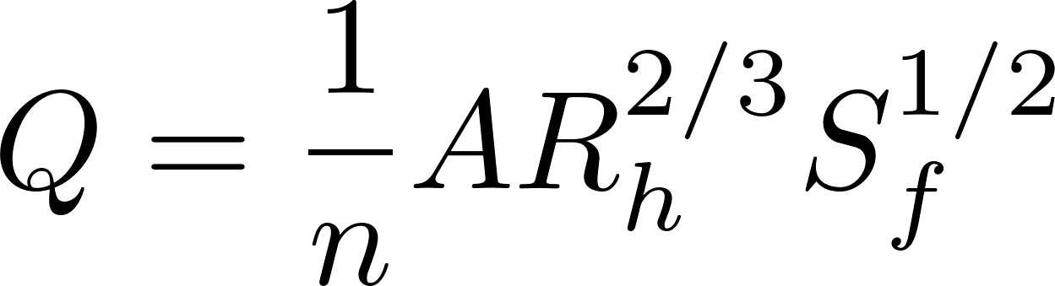
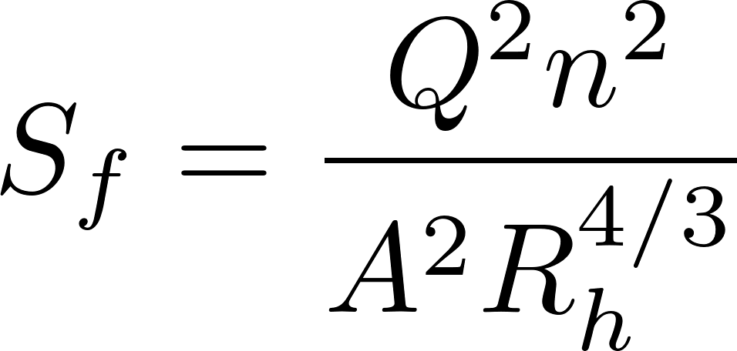
1D Flow Case
Friction slope can be modeled by a variety of equations, such as:
Chezy
Darcy-Weisbach
Manning’s equation
Using Manning’s equation, we can derive:

Slide 8
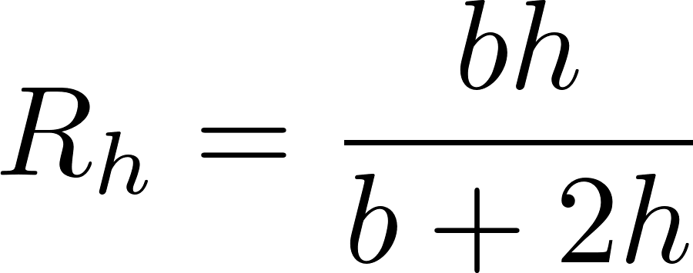
1D Flow Case
To solve the previous equations, we need to know a continuous (or at least a tabular) hydraulic radius function
For simple cases such as a rectangular channel, the hydraulic radius can be written as:

Slide 9
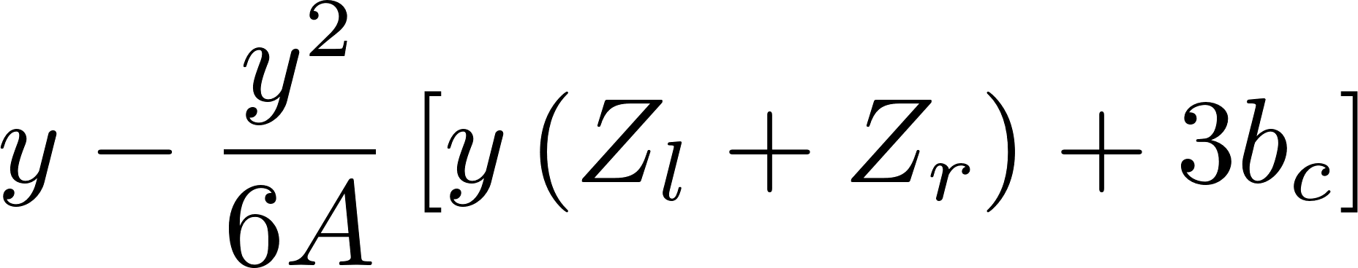
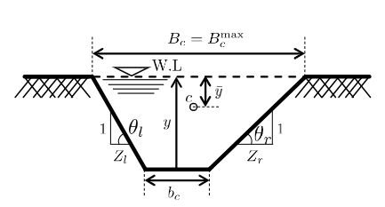
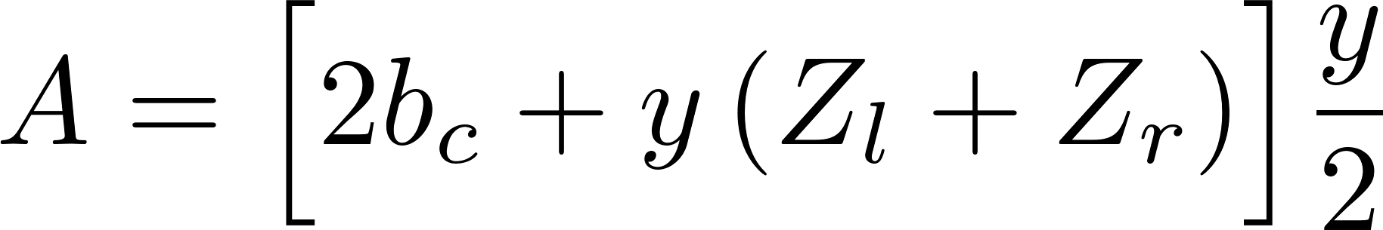
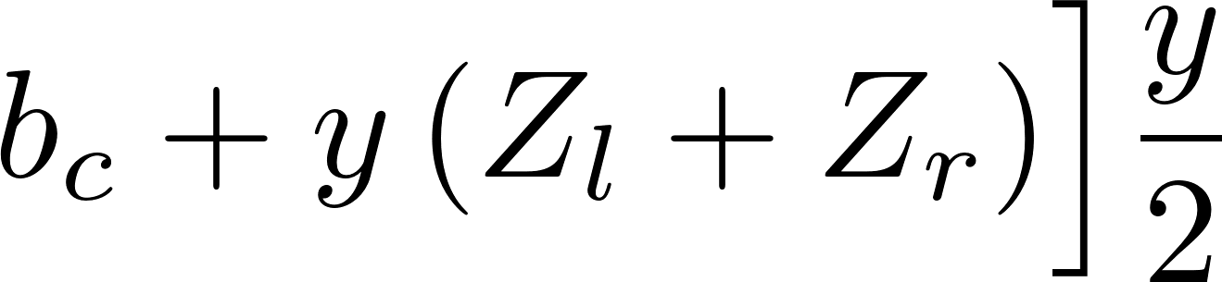
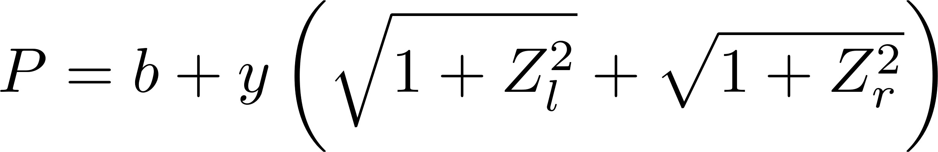
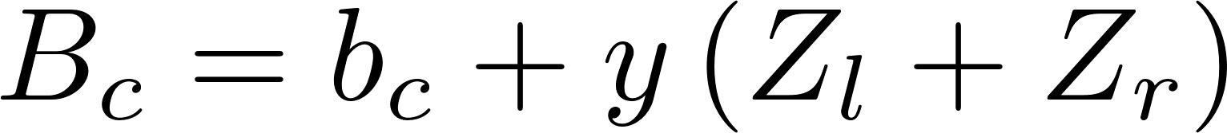
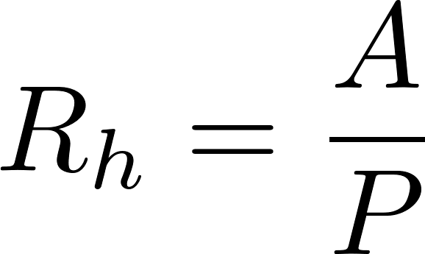
1D Flow Case
Trapezoid Channel
Other complex shape such as parabolic, elliptical and other formats can be solved if the hydraulic functions are known

Slide 10
1D Flow Case
Irregular Cross-Sections are a more complex problem because these functions have sharp variations and cannot be written explicitly
A pre-processing tool can calculate area, perimeter, and all hydraulic properties by varying the depth in incremental steps
The stored results are then used in the hydraulic solver, similarly to the VLOOKUP function in Excel, for instance

Slide 11
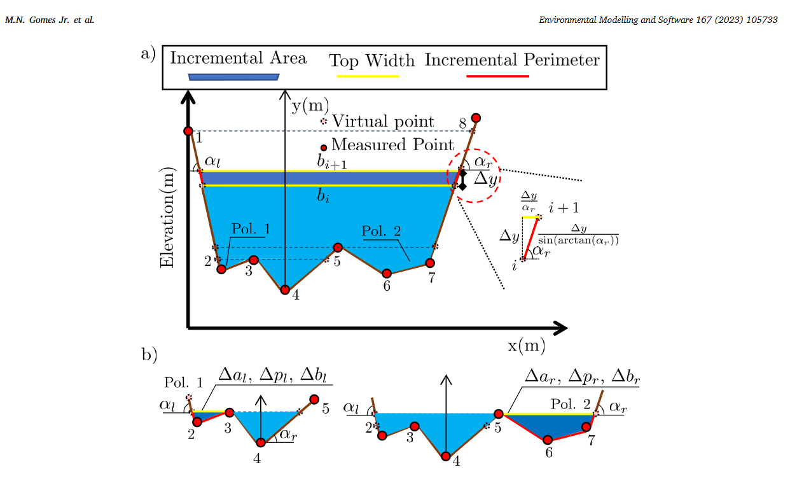
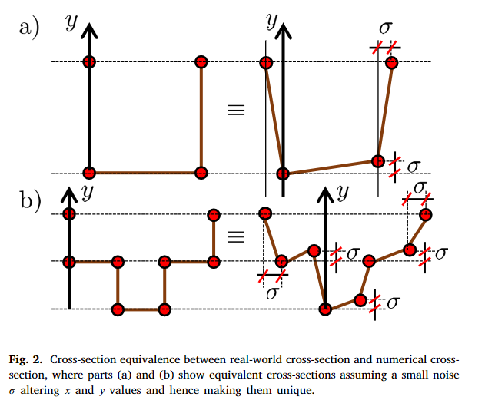
1D Flow Case: Case of Irrregular XS
Gomes Jr, M.N., Rápalo, L.M., Oliveira, P.T., Giacomoni, M.H., do Lago, C.A. and Mendiondo, E.M., 2023. Modeling unsteady and steady 1D hydrodynamics under different hydraulic conceptualizations: Model/Software development and case studies. Environmental Modelling & Software, 167, p.105733.

Slide 12
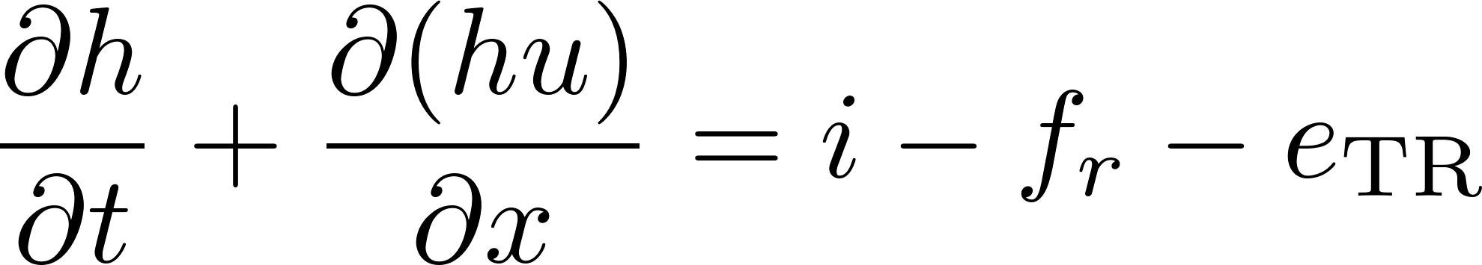
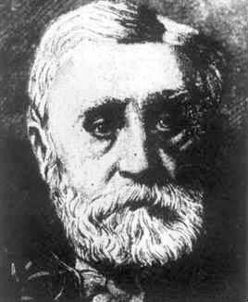
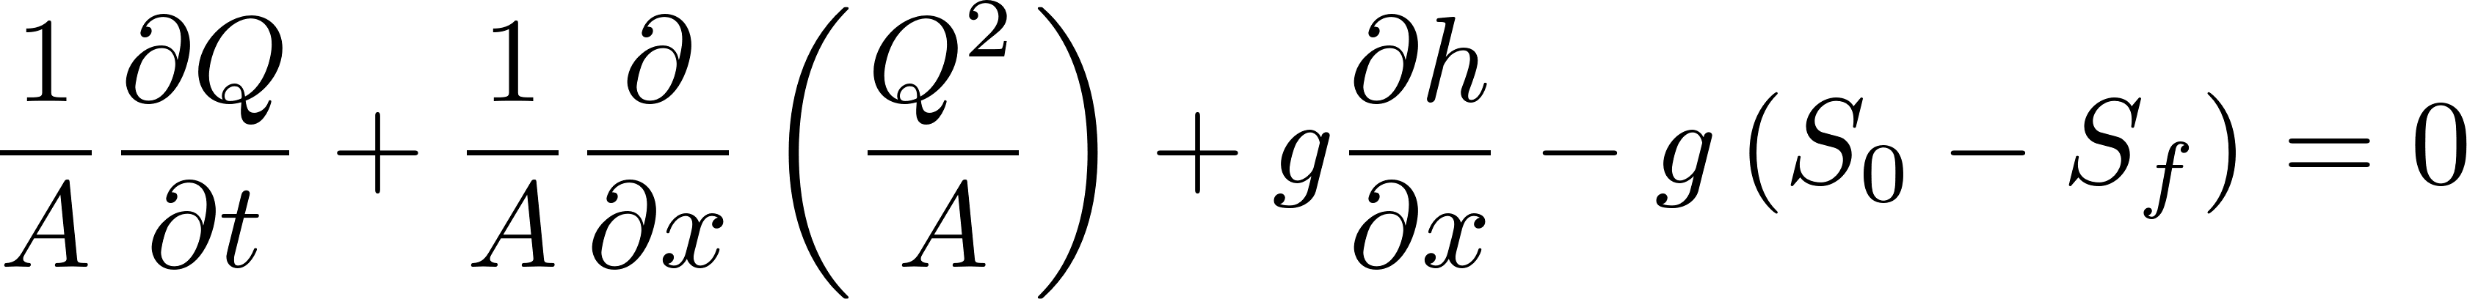
1D Saint Venant Equations (SVE)
By merging the momentum equation with the mass balance equations, the SVE are derived:
Continuity Equation
de St. Venant Equations
Momentum Eq.
Jean Claude Barré de Saint-Venant
1797-1886

Slide 13
Assumptions
Flow is one-dimensional and the depth and velocity vary only in the longitudinal direction of the channel (Water surface is horizontal)
Flow is assumed to vary gradually along the channel so that vertical accelerations can be neglected
The longitudinal axis of the channel is approximated as a straight line
The bottom slope of the channel is small and the channel bed is fixed ⇒ scour and deposition negligible (S₀=tan(θ)=sin(θ))
The fluid is incompressible and of constant density throughout the flow
Jean Claude Barré de Saint-Venant
1797-1886

Slide 14
Applications of HydroHP
Simulation of different cross-sections, such as:
Rectangular
Trapezoidal
Circular
Parabolic
Irregular
Simulation for steady and unsteady-flow cases
Hydraulic properties definition

Slide 15
Applications of HydroHP
Possibility to change the cross-section alongside the x axis
Different boundary conditions allowed such as: inflow hydrograph, stage-hydrograph, mixed, tabular-interpolated inflow hydrograph, normal slope, critical slope
Possibility to simulate complex phenomena such as backwater and dam-break flood propagation
Open souce: Matlab version

Slide 16
How to run the model?
You must have the Matlab 2021 or later installed in your machine
Excel 2013 or higher is also required
The latest version of the model can be download on
Download and extract the zipped files in a folder in your machine (avoid folders that Matlab might not have access)
The main file is
https://github.com/marcusnobrega-eng/HydroHP

Slide 17
How to run the model?
The input file is given by the spreadsheet
This spreadsheet is auto explanatory. Two sheets are available: the Input_Data and the Irregular_Section
The Irregular_Section is only used when irregular cross-sections are modeled

Slide 18
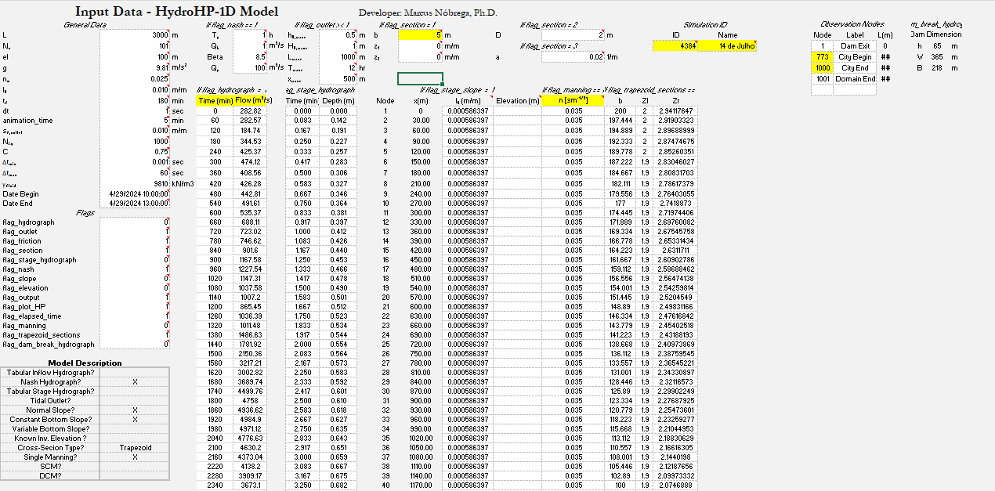
How to run the model?
The Input_Data sheet

Slide 19
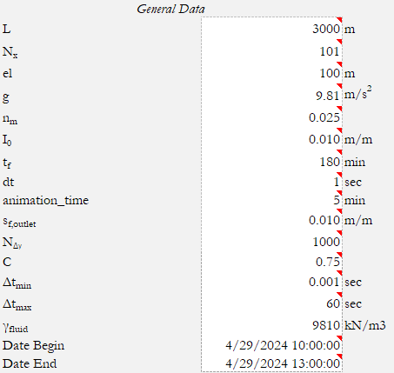
How to run the model?
General Data: controls model discretization, simulation times, some of the boundary conditions and etc

Slide 20
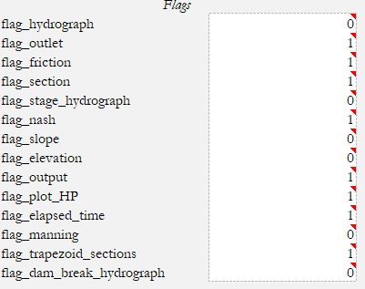
How to run the model?
Flags: controls which boundary conditions are activated and other properties such as the friction model, etc

Slide 21
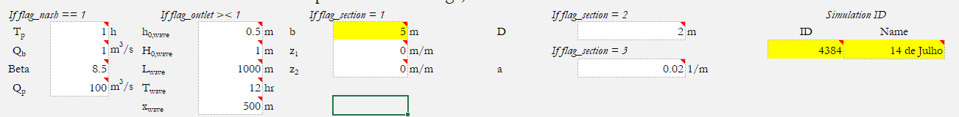
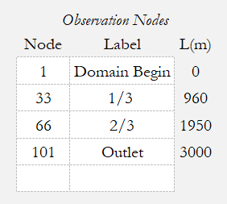
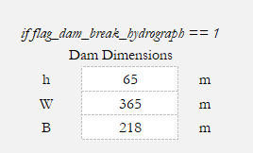
How to run the model?
Extra input

Slide 22
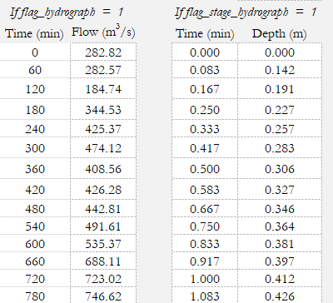
How to run the model?
Time-varying Boundary Conditions

Slide 23
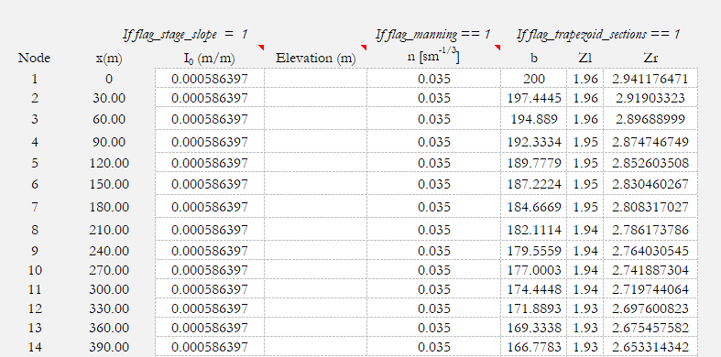
How to run the model?
Space-varying input (if required)

Slide 24

Example
1
Designing a Channel
HydroHP-1D
Hydrodynamic Modeling
Notes:
Photo by Glenn Carstens-Peters on Unsplash: https://unsplash.com/photos/npxXWgQ33ZQ

Slide 25
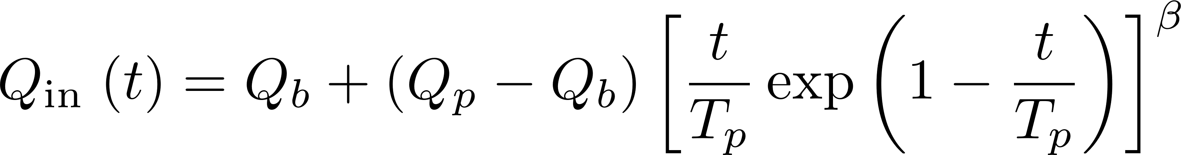
Example 1
Design a rectangular channel with 1% slope to convey the 100-yr flood hydrograph, simulated by a Nash-Hydrograph given by:
where Q_{in} is the upstream inflow hydrograph, Q_{b} = 1 m³/s (baseflow) Q_{p} is the peak flow = 100 m³/s, T_{p} is the peak time, assumed as 60 min, and β is a shape parameter equals 8.5.
Determine the minimum width such that the maximum depth is 5 m at the outlet

Slide 26
Example 1
The outlet boundary condition is assumed as normal slope, following the channel slope
Discretize the domain into 101 nodes, such that the reach is divided in 100 intervals
The reach length is 10 km. Manning’s roughness coefficient is 0.035 sm^{-1/3}
The simulation time is 3-h. The maximum and minimum time-step is 10 sec and 0.001 sec, with a maximum courant number of 0.4.

Slide 27
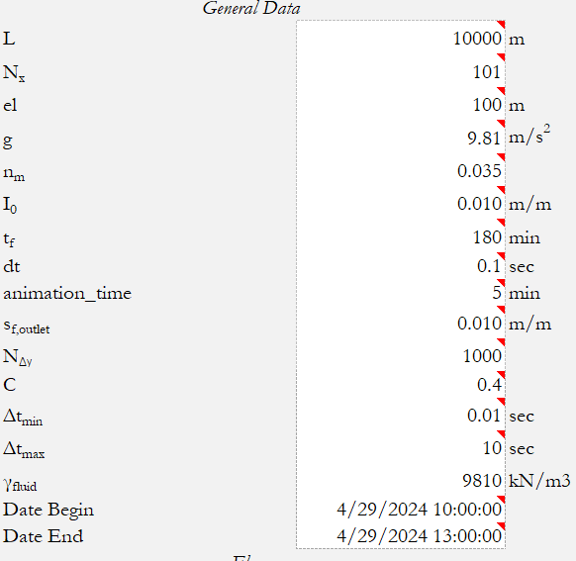
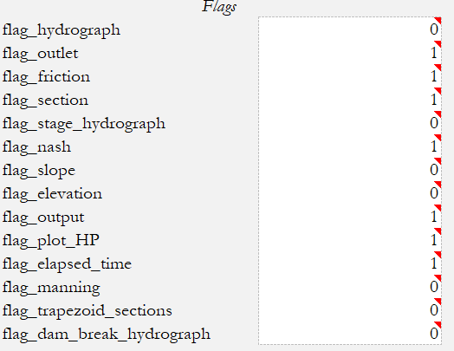
Example 1

Slide 28
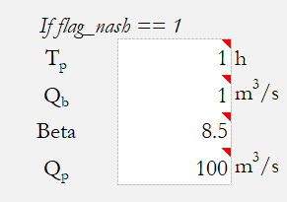
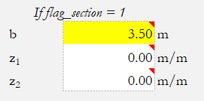
Example 1
Our goal is to find b such that the maximum depth is less than 5m
Initial guess = 3.5 m

Slide 29
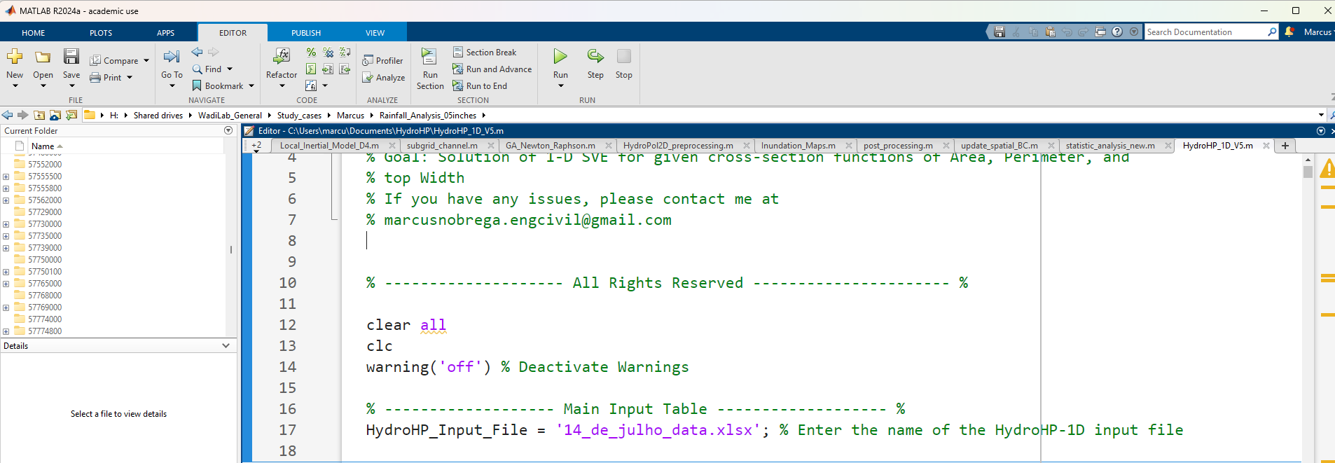
Solution
Make sure all input is filled in the spreadsheet
If the folder is automatically saved on one drive or google drive, you might have to close the file before running
Open the HydroHP_1D main script
Here you can specify a different input spreadsheet

Slide 30
Solution
Let’s change the name of the input spreadsheet to Example_1_Channel_Design.xlsx and input this file to the main code in matlab, such that:
See that I added the folder Examples/ because I saved the spreadsheet in this folder
You can also specify full file paths here

Slide 31
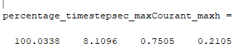
Solution
During the simulation, a status indicating the percentage, the current time-step in sec, the maximum Courant in the simulation and the maximum water depth in m are shown
Results are automatically saved in the model folder (Modeling Results)

Slide 32
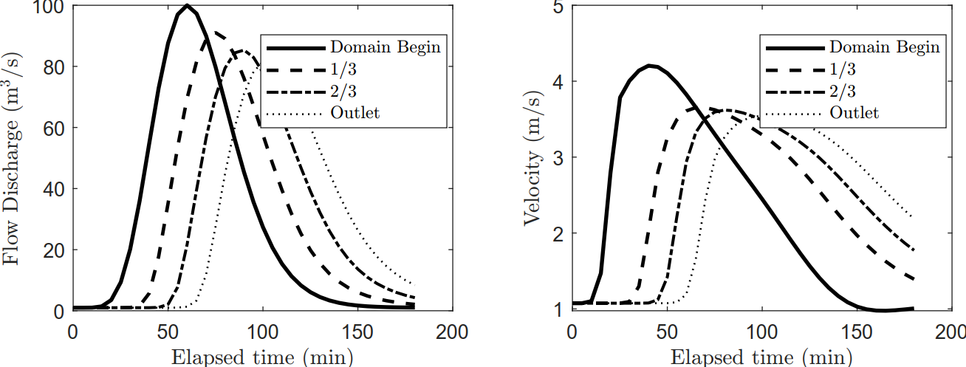
Solution

Slide 33
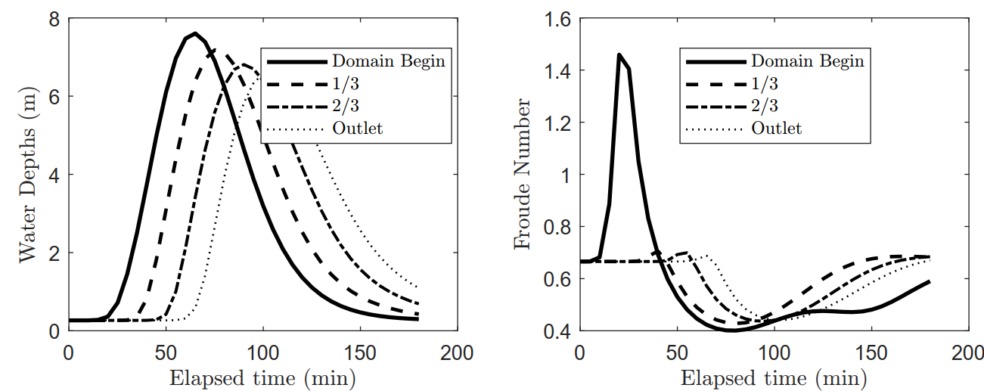
Solution

Slide 34
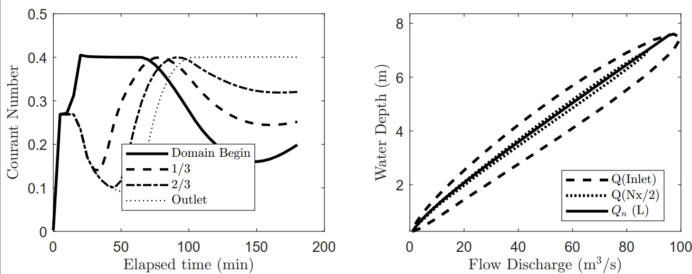
Solution

Slide 35
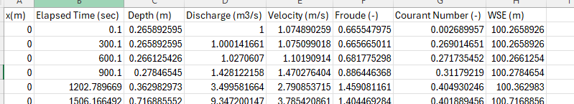
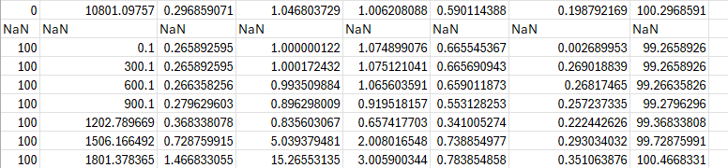
Solution
Detailed Output per Cross-section or per Time (csv files)

Slide 36
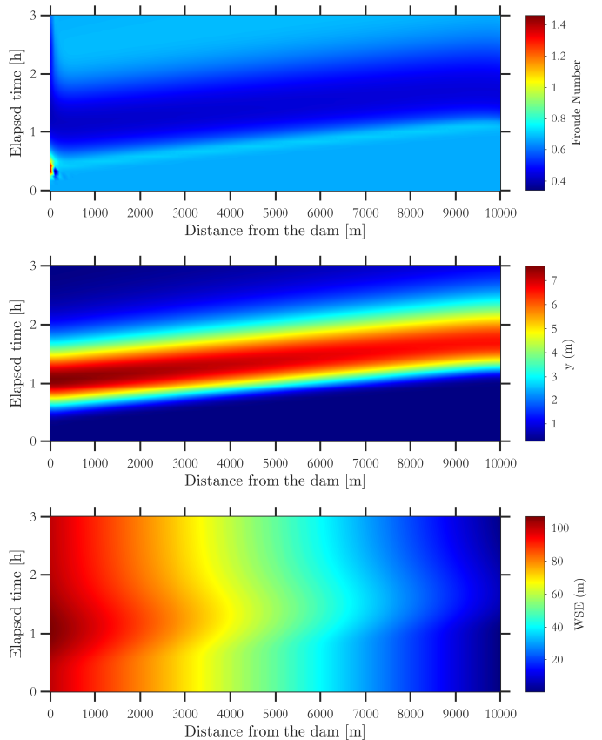
Solution
Surfplots

Slide 37
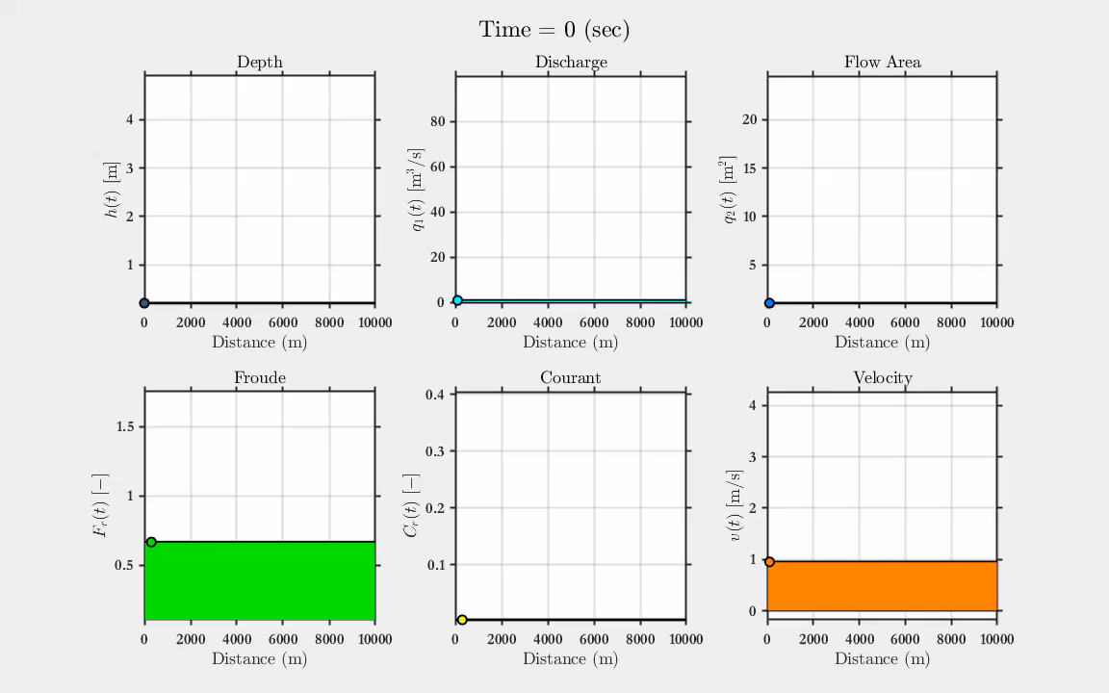
Solution
States

Slide 38
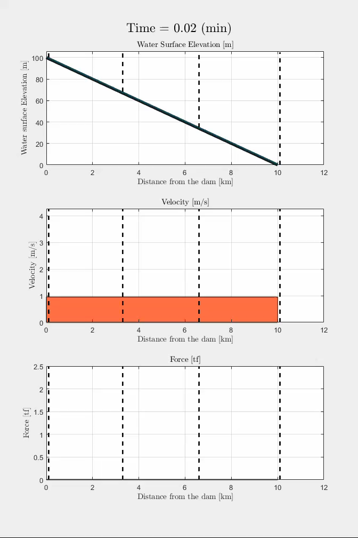
Solution
States

Slide 39
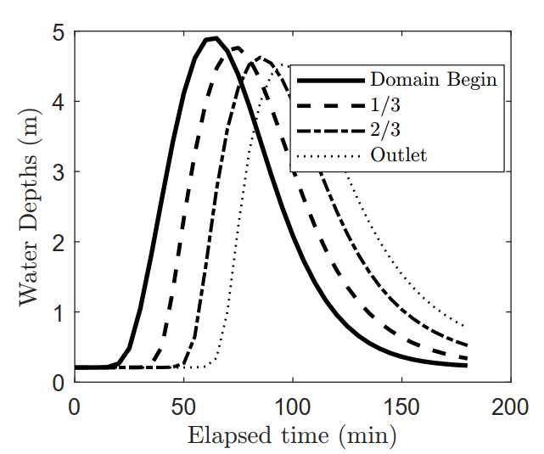
Solution
To satisfy the design, we need to change the channel width to 5 m
Obviously a more optimized could result be achieved, but so far, this solution is ok

Slide 40
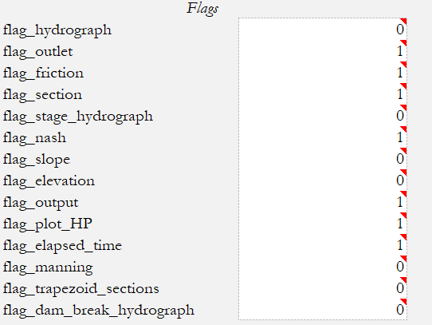
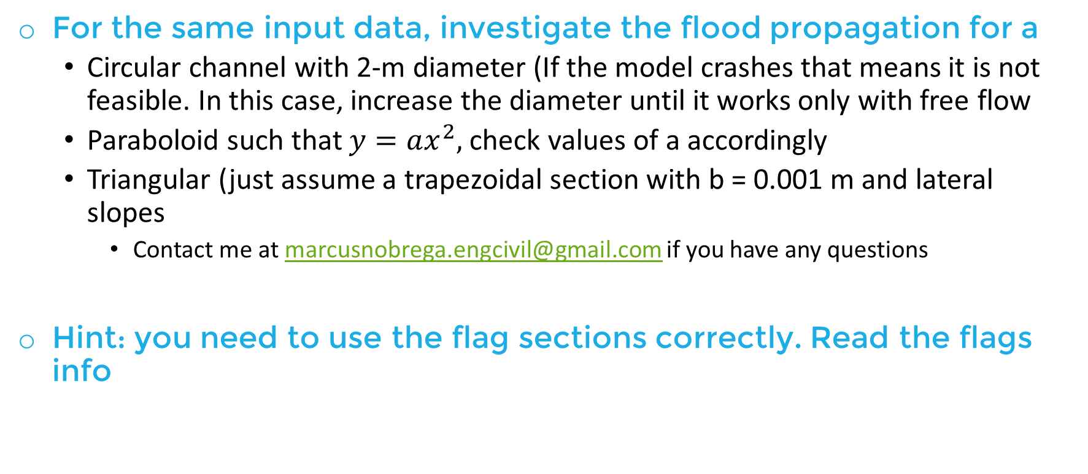
Exercise
For the same input data, investigate the flood propagation for a
Circular channel with 2-m diameter (If the model crashes that means it is not feasible. In this case, increase the diameter until it works only with free flow
Paraboloid such that $y=ax^{2},$ check values of a accordingly
Triangular (just assume a trapezoidal section with b = 0.001 m and lateral slopes
Contact me at marcusnobrega.engcivil@gmail.com if you have any questions
Hint: you need to use the flag sections correctly. Read the flags info

Slide 41
Example
2
Assessing a Dam-Break Problem
HydroHP-1D
Hydrodynamic Modeling
Notes:
Photo by Glenn Carstens-Peters on Unsplash: https://unsplash.com/photos/npxXWgQ33ZQ

Slide 42
Example 2
A dam with dimensions of approximately 60 m height, 2000 m of length and 200 m width suffered an instantaneous failure.
Assuming the downstream floodplain as a trapezoid channel with 2:1 (hxv) slopes and 50-m width, determine the floodwave propagation characteristics for a 10-km reach
Assume a terrain roughness coefficient of 0.035 sm^{-1/3} and S₀ = 1%
Save results each 0.5 min and run the simulation for 60 min
Gomes Jr, M.N., Castro, M.D.A.R.A., da Silva, P.G.C., Giacomoni, M.H. and Mendiondo, E.M., 2024. Increasing flood awareness through dam-break serious games. International Journal of Disaster Risk Reduction, 108, p.104543.

Slide 43
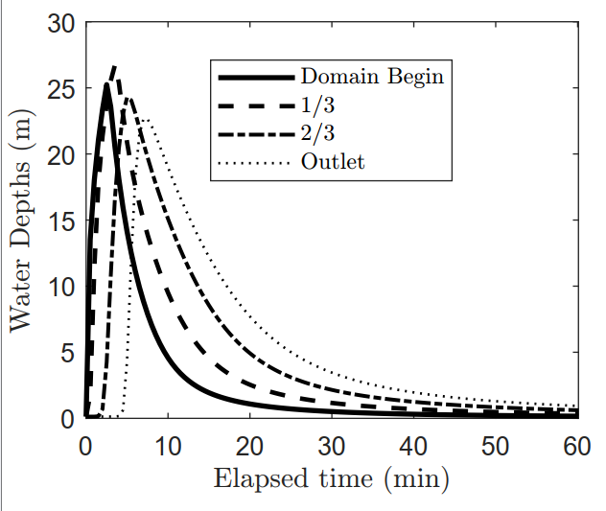
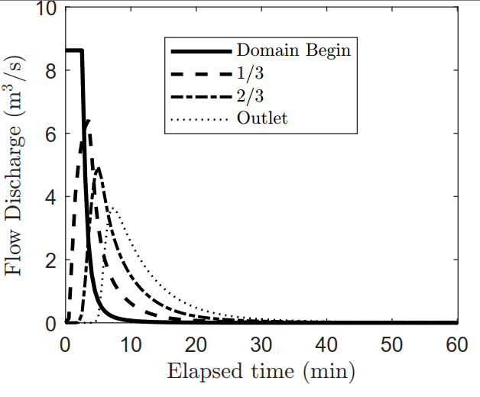
Solution

Slide 44

Example 2

Slide 45
Example
3
The Dam-Break Serious Game Approach
HydroHP-1D
Hydrodynamic Modeling
Notes:
Photo by Glenn Carstens-Peters on Unsplash: https://unsplash.com/photos/npxXWgQ33ZQ

Slide 46


The Dam-Break Tool
Install the File Dam_Breach_Problem
It automatically will appear in your Matlab in (Apps) as:

Slide 47


Installing the App

Slide 48














Problem Schematics

Slide 49

Example of Application

Slide 50
Dam-Break Serious Game Limitations
There is no upstream boundary condition
The initial water depth in the reservoir governs the flow dynamics
An instantaneous failure is assumed such that a very high gradient exists in the first time step and water moves downstream
The downstream channel has the same width as the dam (this is the most important simplification)

Slide 51
Irregular XS
Irregular Cross-Sections are a more complex problem because these functions have sharp variations and cannot be written explicitly
A pre-processing tool can calculate area, perimeter, and all hydraulic properties by varying the depth in incremental steps
The stored results are then used in the hydraulic solver, similarly to the VLOOKUP function in Excel, for instance

Slide 52

HydroHP Model
Input data from Excel Spreadsheets
Model coded in Matlab
Outputs as videos, figures exported in model folder

Slide 53
Example
4
Evaluating a Composite Channel
HydroHP-1D
Hydrodynamic Modeling
Notes:
Photo by Glenn Carstens-Peters on Unsplash: https://unsplash.com/photos/npxXWgQ33ZQ

Slide 54
Example 4
Given a composite river cross section representing a 5-m wide, 1-m-height triangular channel (inbank with n = 0.018) with overbanks of length 1-m (n = 0.035) and vertical walls, estimate the floodwave propagation in a 10 km reach, S₀ = 1%
The inflow hydrograph is the same from example 1. Propagate the floodwave for 3-h

Slide 55
Example 4

Slide 56

Solution

Slide 57

Solution

Slide 58

Solution

Slide 59

Solution

Slide 60

Solution

Slide 61

Solution

Slide 62
Final Remarks
HydroHP has its performance checked against analytical solutions, HEC-RAS, observed river discharges, different composite and irregular cross-sections and so on
The code is open source and you can implement code for your purposes on top of the model
Interesting analysis in the future can be in the direction of adding a sediment or water quality module to investigate the propagation of contaminants

